Slide 1
Data Science Unit-V From: Tom M. Mitchell, Machine Learning, India Edition 2013, McGraw Hill Education.
ARTIFICIAL NEURAL NETWORKS

Slide 2
CONTENT
Introduction
Neural Network Representation
Appropriate Problems for Neural Network Learning
Perceptrons
Multilayer Networks and BACKPROPAGATION Algorithms
Remarks on the BACKPROPAGATION Algorithms
Advanced Topics in Artificial Neural Networks.
Case Study: Defeating a CAPTCHA

Slide 3
Introduction: How can we answer this problems?
Pattern recognition: Does that image contain a face?
Classification problems: Is this product defective?
Prediction: Given these symptoms, the patient has disease X
Forecasting: predicting behavior of stock market
Handwriting: is character recognized?
Optimization: Find the shortest path for the .
Neural Networks can be used to solve these problems

Slide 4
When to consider Neural Networks ?
Input is a high-dimensional discrete or real-valued (e.g., sensor input)
Output is discrete or real-valued
Output is a vector of values
Possibly noisy data
Form of target function is unknown
Human readability of result is unimportant
Examples:
Speech phoneme recognition
Image classification
Financial perdition

Slide 5
INTRODUCTION
Artificial neural networks (ANNs) provide a general, practical method for learning real-valued, discrete-valued, and vector-valued target functions from examples.

Slide 6
Biological Motivation
The study of artificial neural networks (ANNs) has been inspired by the observation that biological learning systems are built of very complex webs of interconnected Neurons
Human information processing system consists of brain neuron: basic building block cell that communicates information to and from various parts of body
Simplest model of a neuron: considered as a threshold unit –a processing element (PE)
Collects inputs & produces output if the sum of the input exceeds an internal
threshold value

Slide 7
Facts of Human Neurobiology
Number of neurons ~ 10¹¹
Connection per neuron ~ 10 ^{4 – 5}
Neuron switching time ~ 0.001 second or 10 ⁻³
Scene recognition time ~ 0.1 second
100 inference steps doesn’t seem like enough
Highly parallel computation based on distributed representation
Properties of Neuron:
Many neuron-like threshold switching units
Many weighted interconnections among units
Highly parallel, distributed process
Emphasis on tuning weights automatically
Input is a high-dimensional discrete or real-valued (e.g, sensor input)

Slide 8
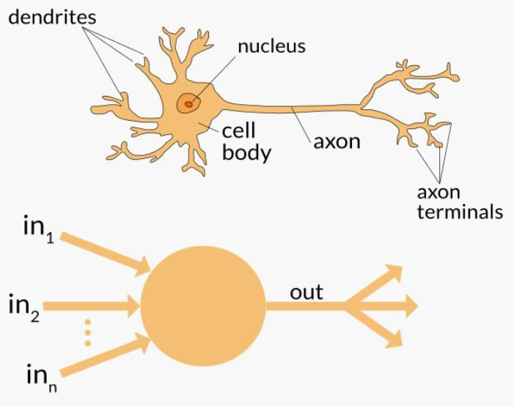
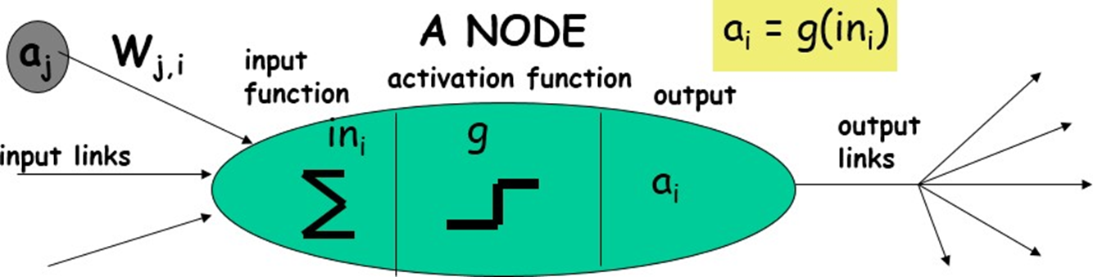
Neuron

Slide 9
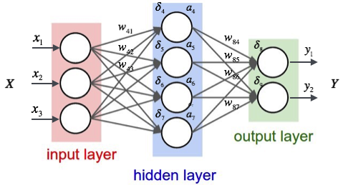
What Is an Artificial Neural Network (ANN)?
Artificial Neural Network is a Deep Learning model that draws inspiration from the neural structure of the human brain.
An artificial neural network (ANN) is the piece of a computing system designed to simulate the way the human brain analyzes and processes information.
ANNs have self-learning capabilities that enable them to produce better results as more data becomes available.
Structure of ANN:

Slide 10
Topological units of ANN:
Neural Network.
Is a Mathematical model.
Inspired by Human biological neurons and now leading in solving many real world problems
ANN topology Units include:
Neurons.
Layers.
Connecting Links.
Initial weights(on links)
and bias and activation function
Inputs/outputs

Slide 11
Properties of ANNs
Supports many neuron- which act like threshold switching units.
Has many weighted interconnections among units, to improve the NN learning process.
Emphasis on tuning network weights automatically, to reduce the learning error.
supports robustness, non-linearity, high parallelism, fault and failure tolerance, ability to handle imprecise and fuzzy information, and generalizing ability.
Input is a high-dimensional discrete or real-valued (e.g, sensor input)

Slide 12

ANN Architecture:
Bias
b
x₁
w₁
Activation
function
Local
Field
v
Output
y
Input
values
x₂
w₂
Summing
function
x_{m}
w_{m}
weights

Slide 13
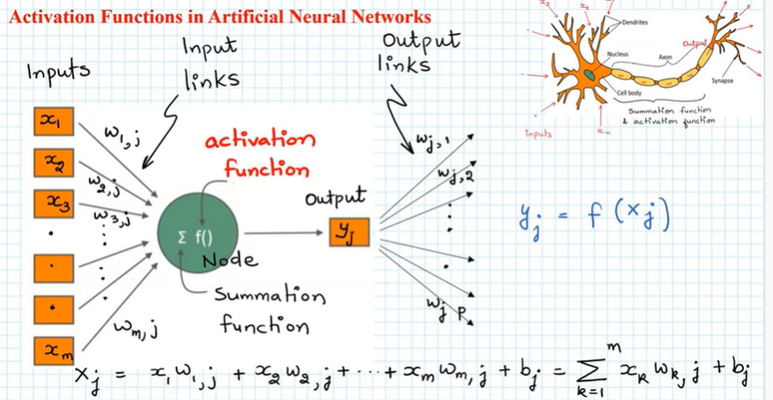
Activation Functions

Slide 14
Activation Functions:
Activation function is one of the building blocks on Neural Network
Activation function is added for Hidden and O/P layers.
The purpose of an activation function is to add some kind of non-linear property to the input.
Without the activation functions, the only mathematical operation during the forward propagation would be dot-products between an input vector and a weight matrix: which is linear
The activation functions help the network use the important information and suppress the irrelevant data points.
Can we do without an activation function?
A neural network without an activation function is essentially just a linear regression model.

Slide 15
Why nonlinear Activation function: (ex: sigmoid)
Linear functions always do exhibit a constant slope.
Slope as we know pictures the rate of change of the predictor variable (y) with respect to the independent variable (x).
Real-world problems emphasize on finding the points of minimal or maximal change: may be minimization of loss or maximization of gain.
If we take linear activation functions, these changes are constant and cannot be distinguishable between points of minimal and maximal changes.
Nonlinear activation functions have gradients that vary between various points.
Based on these gradients descent or accent, we can address all the minimization and maximization problems.
.

Slide 16
Why nonlinear Activation function: (ex: sigmoid)
The nonlinear exponential function e^{X} has a range between [0, ∞] and has an infinite range.
The gradients for the function e^{X} exist between [0, ∞].
To find the optimal gradients, it is quite difficult within this infinite range.
Hence, such functions though nonlinear cannot be taken as activation functions.
Hence, the needs for activation functions which show active gradients within shorter intervals are needed.
One such is the sigmoid activation function which will analyze the gradients between a small [0, 1] interval

Slide 17
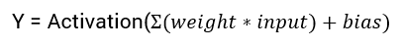
Input to neuron: x = (weight * input) + bias
Post that, an activation function is applied on the above result, x
Imagine a neural network without the activation functions.
In that case, every neuron will only be performing a linear transformation on the inputs using the weights and biases.
Although linear transformations make the neural network simpler, but this network would be less powerful and will not be able to learn the complex patterns from the data.
Thus we use a non linear transformation to the inputs of the neuron and his non-linearity in the network is introduced by an activation function.

Slide 18
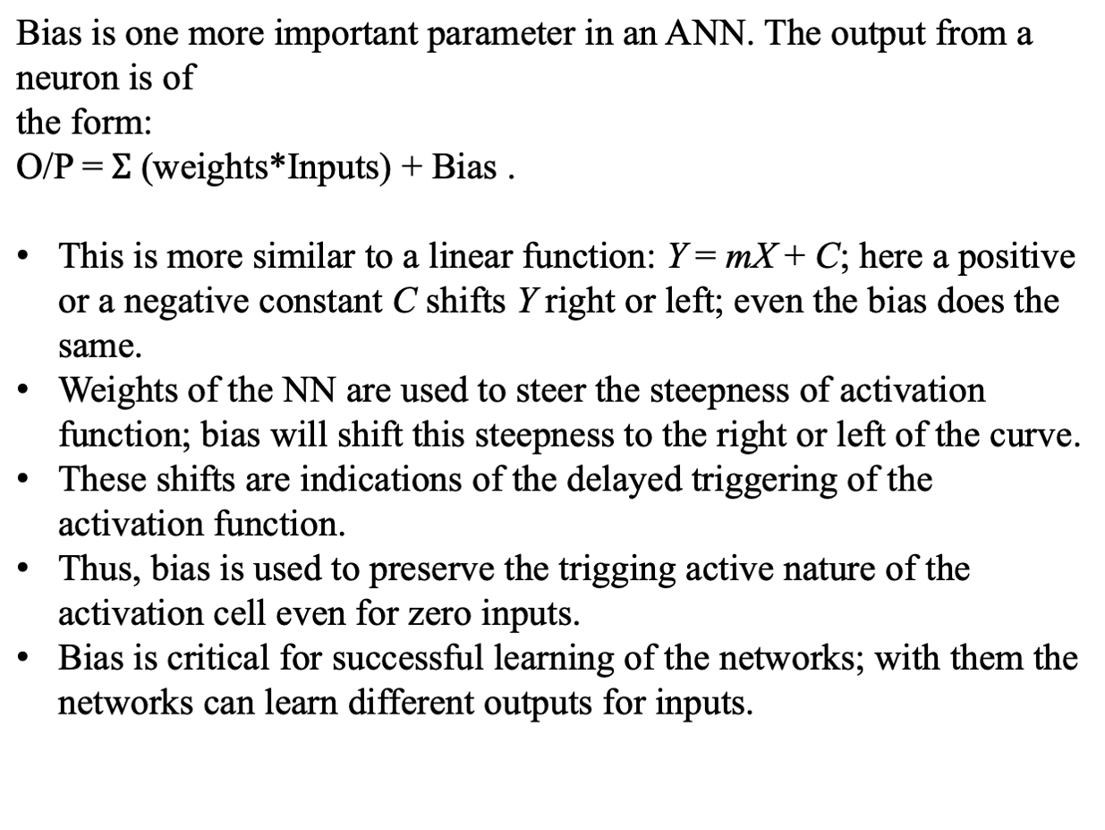
Role of Bias:

Slide 19
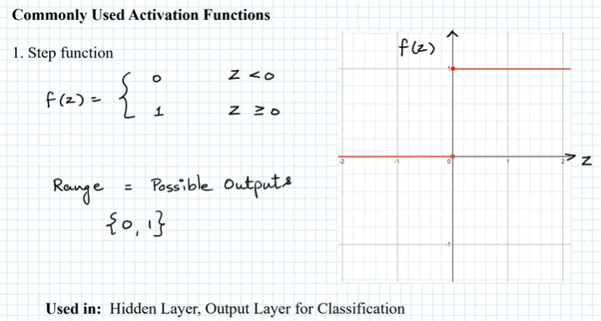
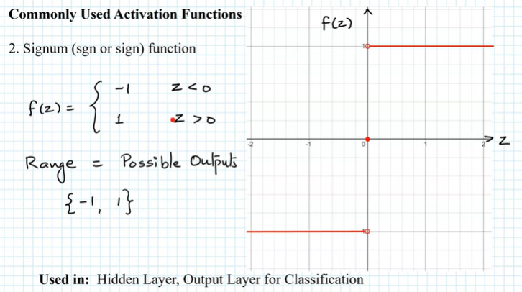
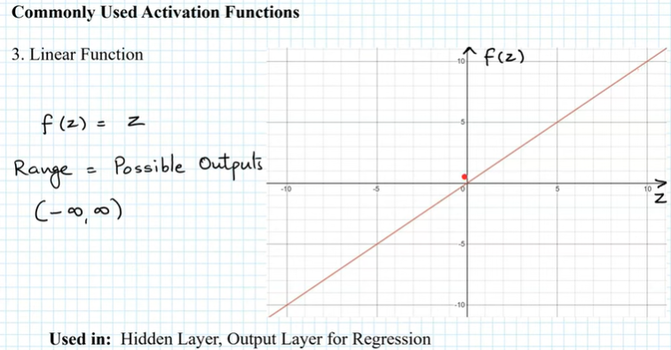
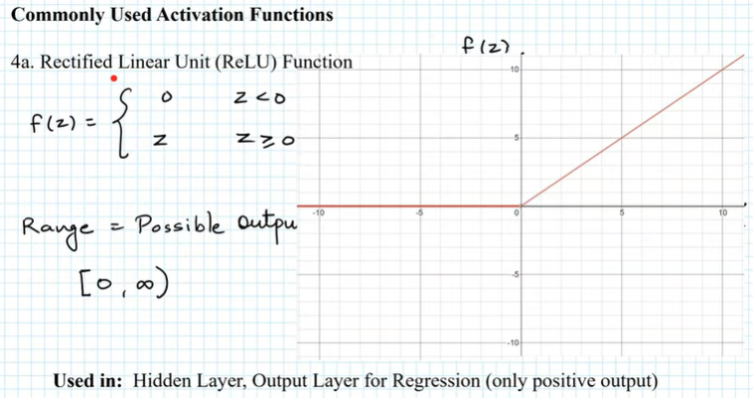
Types of Activation functions

Slide 20
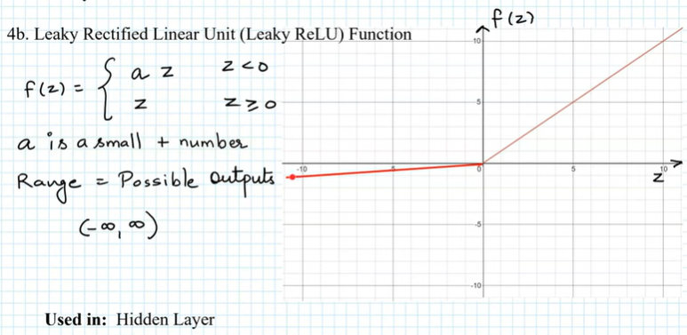
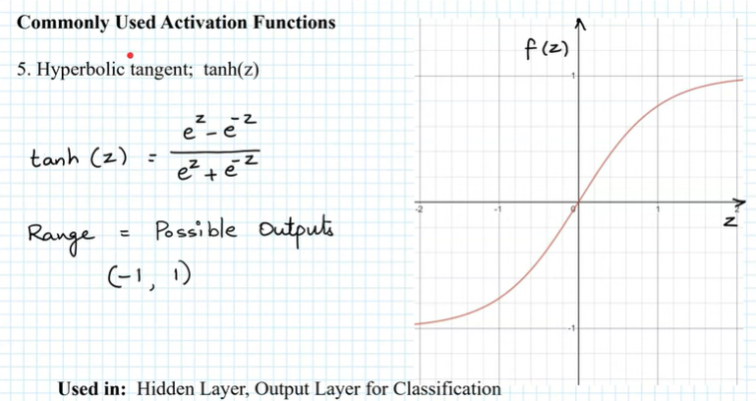
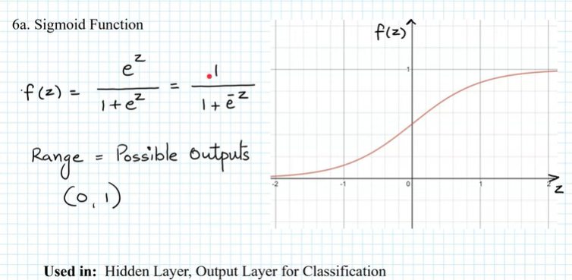
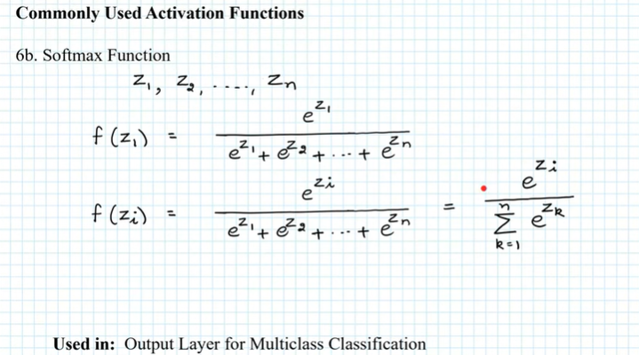
Types of Activation functions

Slide 21
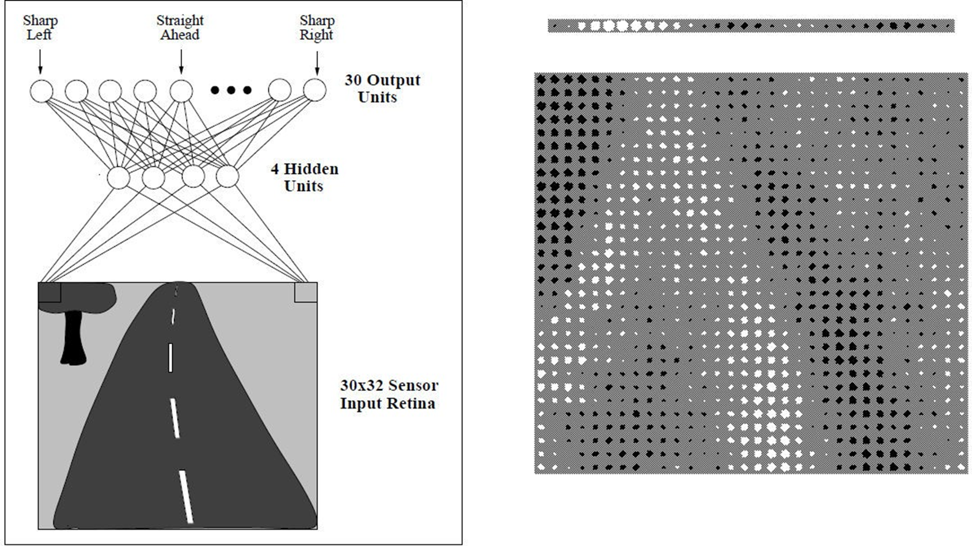
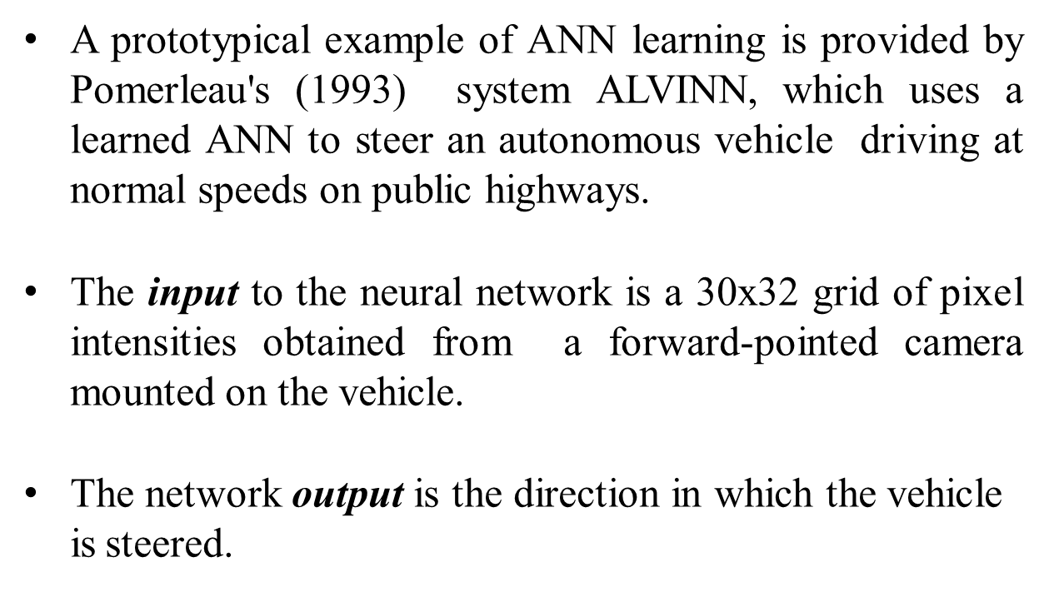
Neural Networks representation

Slide 22
Figure illustrates the neural network representation.
The network is shown on the left side of the figure, with the input camera image depicted below it.
Each node (i.e., circle) in the network diagram corresponds to the output of a
single network unit, and the lines entering the node from below are its inputs.
There are four units that receive inputs directly from all of the 30 x 32 pixels in the image. These are called "hidden" units because their output is available only within the network and is not available as part of the global network output. Each of these four hidden units computes a single real-valued output based on a weighted combination of its 960 inputs
These hidden unit outputs are then used as inputs to a second layer of 30 "output"
units.
Each output unit corresponds to a particular steering direction, and the output values of these units determine which steering direction is recommended most strongly.
The diagrams on the right side of the figure depict the learned weight values associated with one of the four hidden units in this ANN.
The large matrix of black and white boxes on the lower right depicts the weights from the 30 x 32 pixel inputs into the hidden unit. Here, a white box indicates a positive weight, a black box a negative weight, and the size of the box indicates the weight magnitude.
The smaller rectangular diagram directly above the large matrix shows the weights from this hidden unit to each of the 30 output units.

Slide 23
APPROPRIATE PROBLEMS FOR NEURAL NETWORK LEARNING
ANN is appropriate for problems with the following characteristics :
Instances are represented by many attribute-value pairs.
The target function output may be discrete-valued, real-valued, or a vector of several real- or discrete-valued attributes.
The training examples may contain errors.
Long training times are acceptable.
Fast evaluation of the learned target function may be required
The ability of humans to understand the learned target function is not important

Slide 24
Architectures of Artificial Neural Networks
An artificial neural network can be divided into three parts (layers), which are known as:
Input layer: This layer is responsible for receiving information (data), signals, features, or measurements from the external environment. These inputs are usually normalized within the limit values produced by activation functions
Hidden, intermediate, or invisible layers: These layers are composed of neurons which are responsible for extracting patterns associated with the process or system being analysed. These layers perform most of the internal processing from a network.
Output layer : This layer is also composed of neurons, and thus is responsible for producing and presenting the final network outputs, which result from the processing performed by the neurons in the previous layers.

Slide 25
Architectures of Artificial Neural Networks
The main architectures of artificial neural networks, considering the neuron disposition, how they are interconnected and how its layers are composed, can be divided as follows:
Single-layer feedforward network
Multi-layer feedforward networks
Recurrent or Feedback networks
Mesh networks

Slide 26
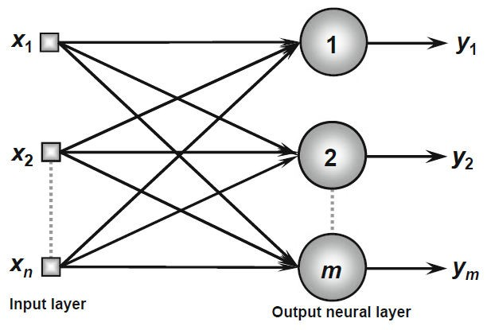
Single-Layer Feedforward Architecture
This artificial neural network has just one input layer and a single neural layer, which is also the output layer.
Figure illustrates a simple-layer feedforward network composed of n inputs and m outputs.
The information always flows in a single direction (thus, unidirectional), which is from the input layer to the output layer

Slide 27
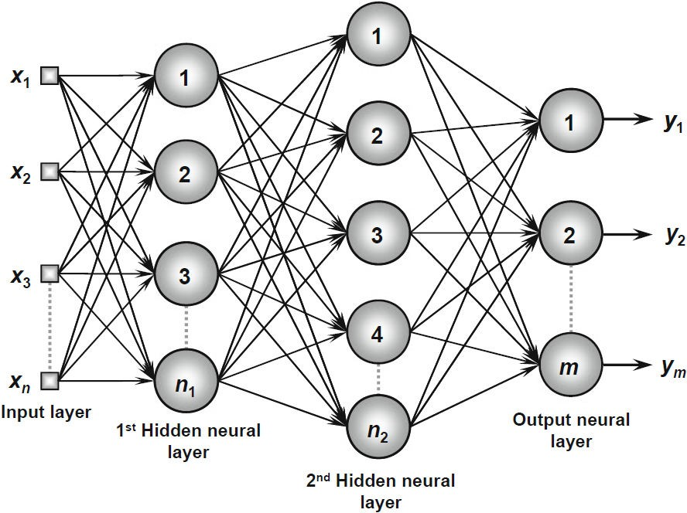
Multi-Layer Feedforward Architecture
This artificial neural feedforward networks with multiple layers are composed of one or more hidden neural layers.
Figure shows a feedforward network with multiple layers composed of one input layer with n sample signals, two hidden neural layers consisting of n₁ and n₂ neurons respectively, and, finally, one output neural layer composed of m neurons representing the respective output values of the problem being analyzed
.

Slide 28
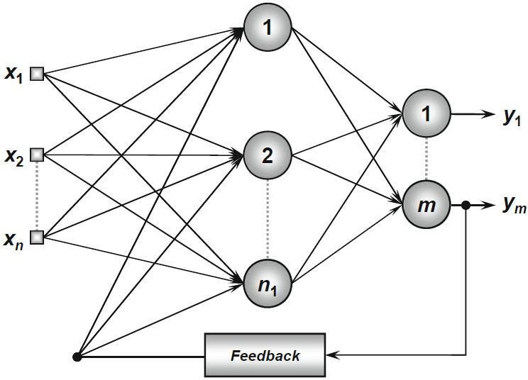
Recurrent or Feedback Architecture
In these networks, the outputs of the neurons are used as feedback inputs for other neurons.
Figure illustrates an example of a Perceptron network with feedback, where one of its output
signals is fed back to the middle layer.

Slide 29
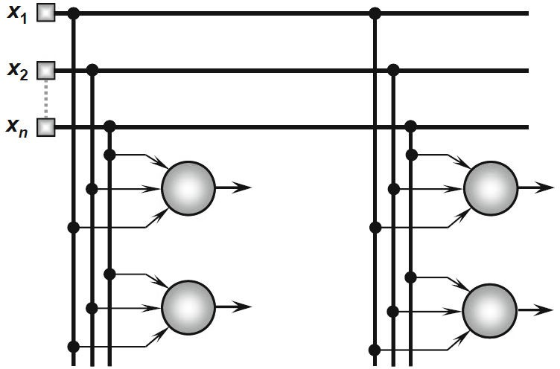
Mesh Architectures
The main features of networks with mesh structures reside in considering the spatial arrangement of neurons for pattern extraction purposes, that is, the spatial localization of the neurons is directly related to the process of adjusting their synaptic weights and thresholds.
Figure illustrates an example of the Kohonen network where its neurons are arranged within a two- dimensional space

Slide 30
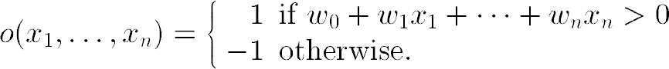
PERCEPTRONS
Perceptron is a single layer neural network.
A perceptron takes a vector of real-valued inputs, calculates a linear combination of these inputs, then outputs a 1 if the result is greater than some threshold and -1 otherwise
Given inputs x₁ through x_{n}, the output O(x₁, . . . , x_{n}) computed by the perceptron is
where each w_{i} is a real-valued constant, or weight, that determines the contribution
of input x_{i} to the perceptron output.
-w₀ is a threshold that the weighted combination of inputs w₁x₁ + . . . + w_{n}x_{n} must surpass in order for the perceptron to output a 1.

Slide 31
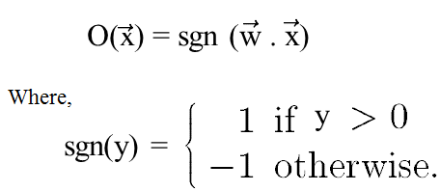
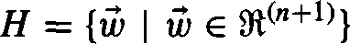
Sometimes, the perceptron function is written as,
Learning a perceptron involves choosing values for the weights w₀ , . . . , w_{n} . Therefore, the space H of candidate hypotheses considered in perceptron learning is the set of all possible real-valued weight vectors
Why do we need Weights and Bias?
Weights shows the strength of the particular node.
A bias value allows you to shift the activation function curve up or down

Slide 32
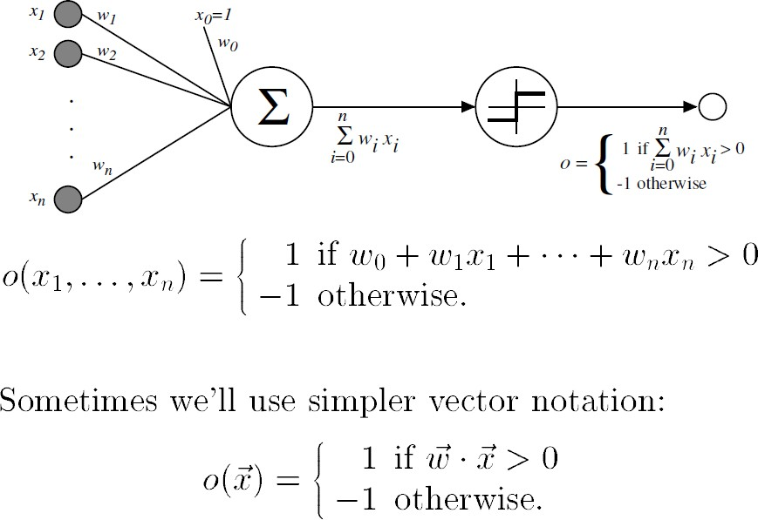

Slide 33
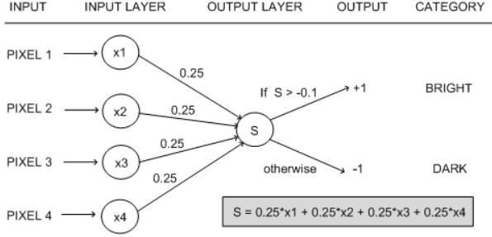

Slide 34
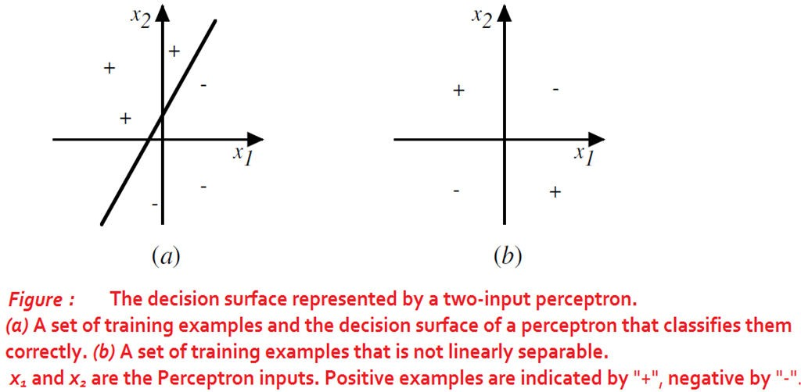
Representational Power of Perceptrons
The perceptron can be viewed as representing a hyperplane decision surface in the n-dimensional space of instances.
The perceptron outputs a 1 for instances lying on one side of the hyperplane and outputs a -1 for instances lying on the other side

Slide 35
The Perceptron Training Rule
The learning problem is to determine a weight vector that causes the perceptron to produce the correct + 1 or - 1 output for each of the given training examples.
To learn an acceptable weight vector
Begin with random weights, then iteratively apply the perceptron to each training
example, modifying the perceptron weights whenever it misclassifies an example.
This process is repeated, iterating through the training examples as many times as needed until the perceptron classifies all training examples correctly.
Weights are modified at each step according to the perceptron training rule, which revises the weight w_{i} associated with input x_{i} according to the rule.

Slide 36
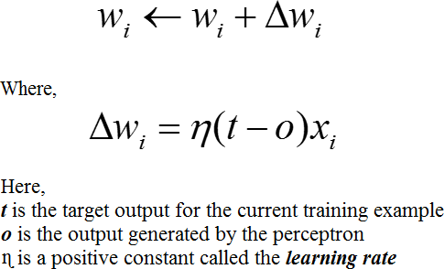
The role of the learning rate is to moderate the degree to which weights are changed at each step. It is usually set to some small value (e.g., 0.1) and is sometimes made to decay as the number of weight-tuning iterations increases
Drawback: The perceptron rule finds a successful weight vector when the training examples are linearly separable, it can fail to converge if the examples are not linearly separable. This can overcome with Gradient decent Delta rule

Slide 37
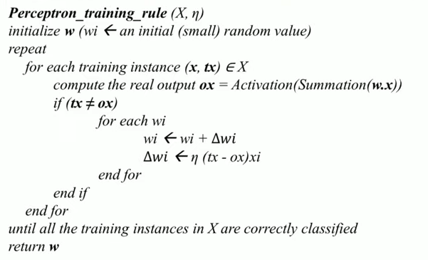
Perceptron Algorithm

Slide 38
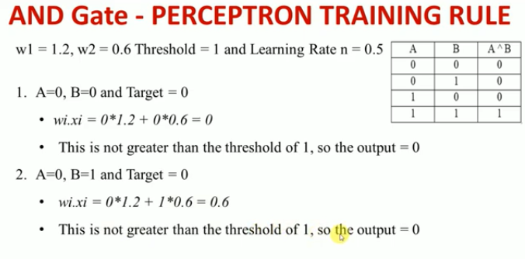
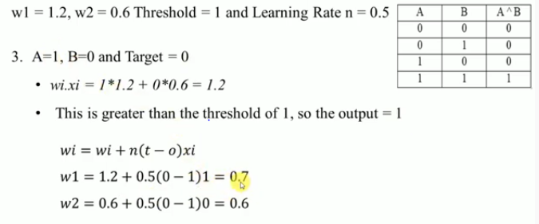

Slide 39
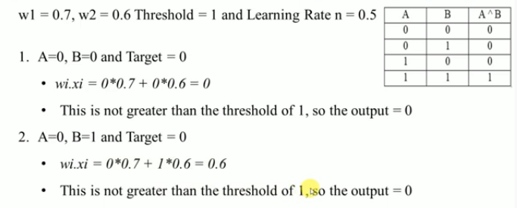
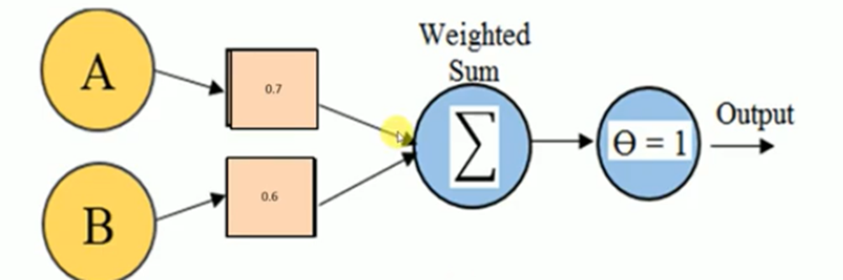
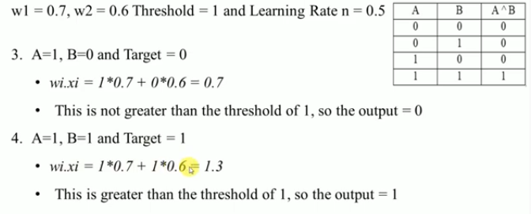

Slide 40
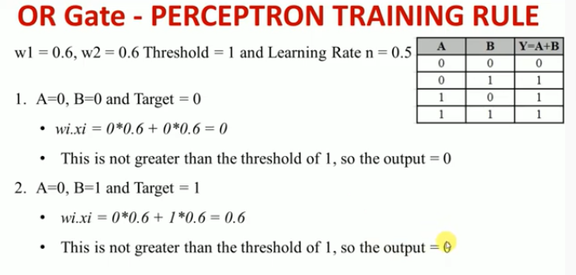
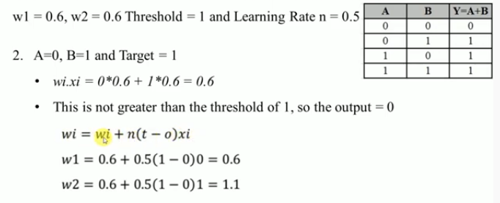

Slide 41
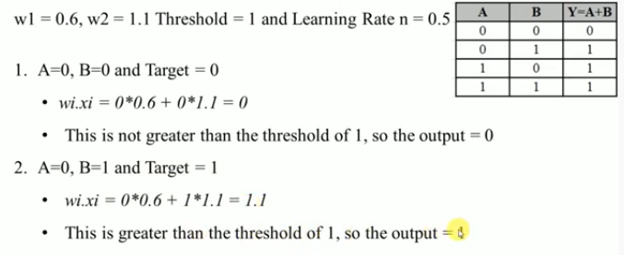
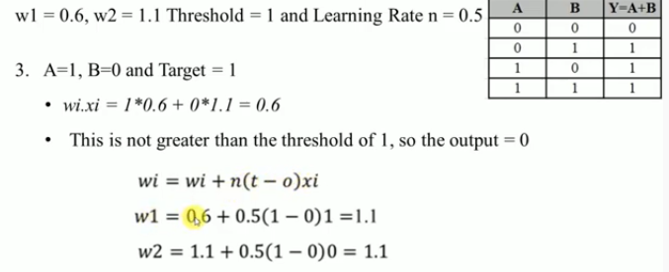

Slide 42
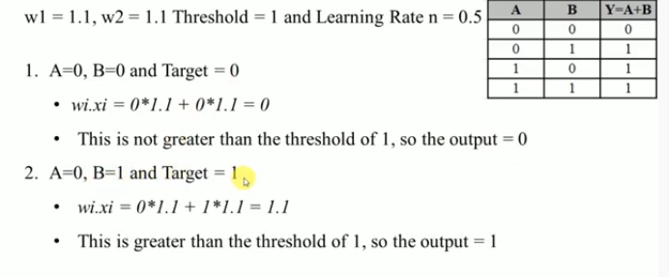
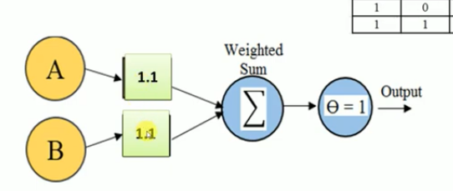
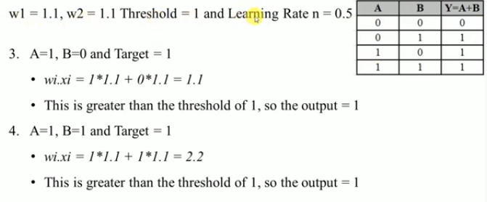

Slide 43
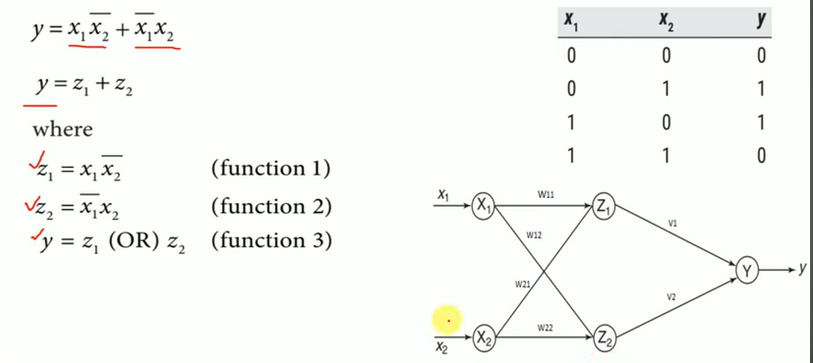
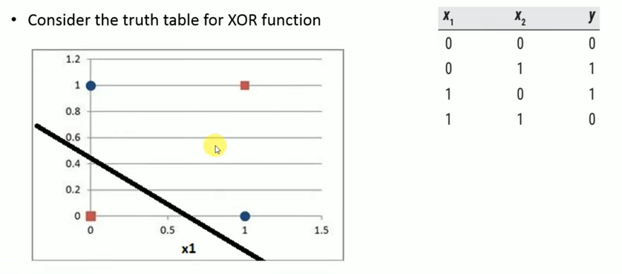
Design perceptron model for Exclusive OR Gate

Slide 44
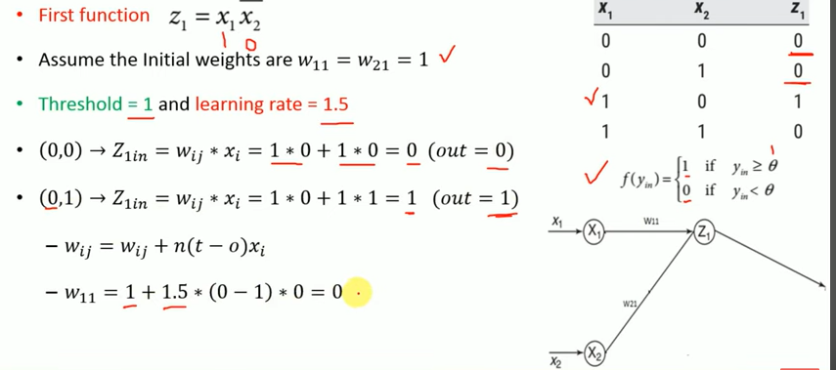

Slide 45
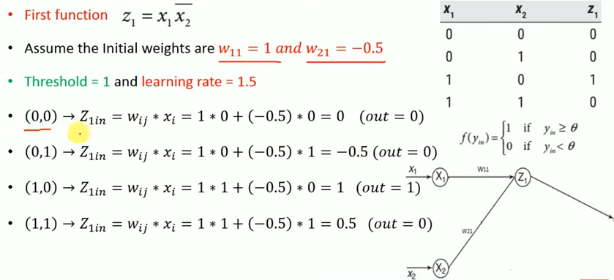

Slide 46
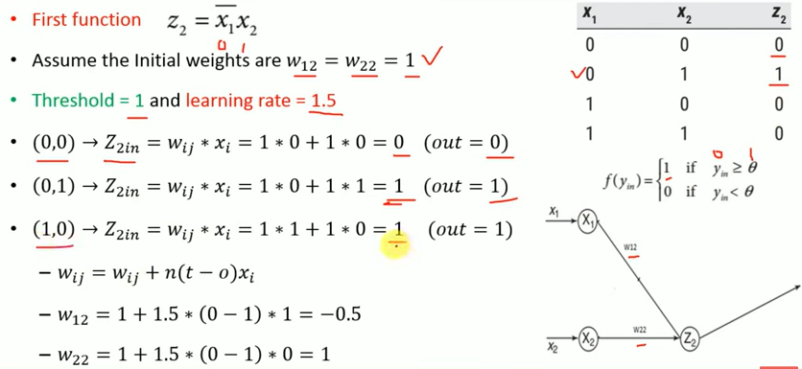

Slide 47
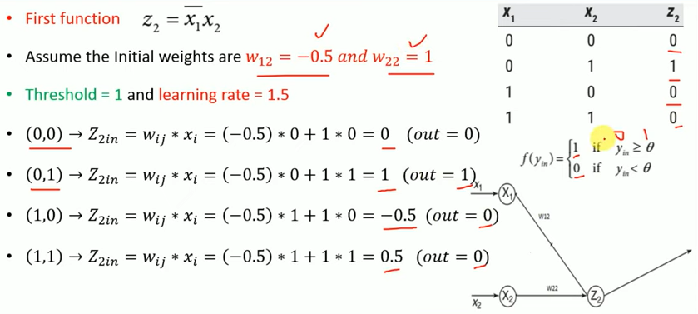

Slide 48
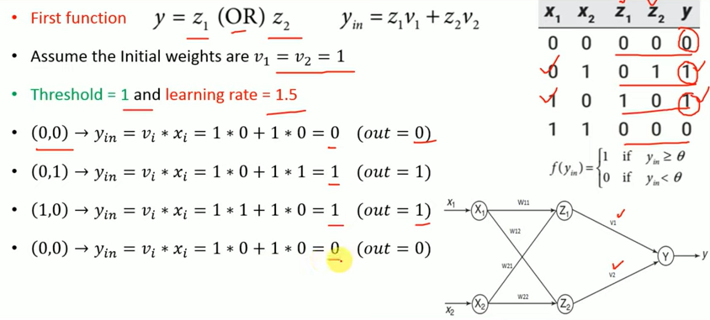

Slide 49
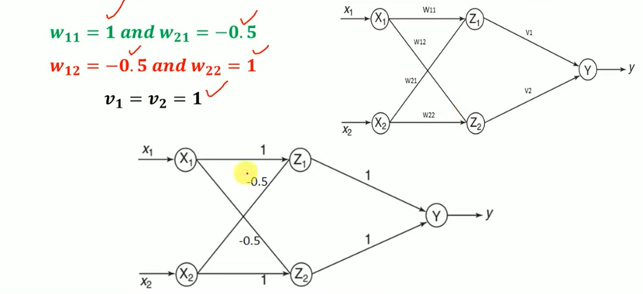

Slide 50
Exercises:
Design perceptron model for
A implies B (Negation A OR B)
Negation A
Negation A AND B

Slide 51
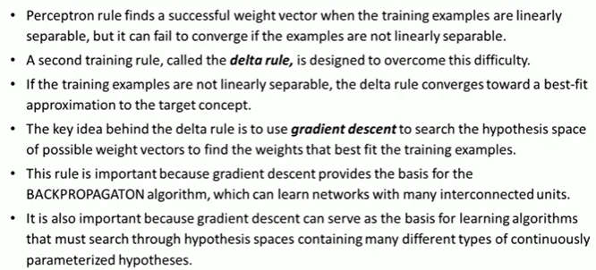
Gradient Descent and the Delta Rule

Slide 52
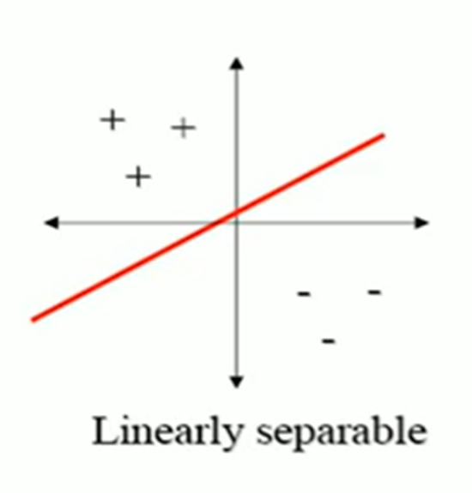


Gradient Descent and the Delta Rule
If the training examples are not linearly separable, the delta rule converges toward a best-fit approximation to the target concept.
OR,AND=Linearly separable, XOR = not linearly separable
The key idea behind the delta rule is to use gradient descent to search the hypothesis space of possible weight vectors to find the weights that best fit the training examples.
To understand the delta training rule, consider the task of training an un thresholded perceptron. That is, a linear unit for which the output O is given by

Slide 53


To derive a weight learning rule for linear units, specify a measure for the training error of a hypothesis (weight vector), relative to the training examples.
Gradient Descent and the Delta Rule
Where,
D is the set of training examples,
t_{d} is the target output for training example d,
o_{d} is the output of the linear unit for training example d
E [ w ] is simply half the squared difference between the target output t_{d} and the linear unit output o_{d}, summed over all training examples.

Slide 54
Visualizing the Hypothesis Space
To understand the gradient descent algorithm, it is helpful to visualize the entire hypothesis space of possible weight vectors and their associated E values as shown in below figure.
Here the axes w₀ and w_{l} represent possible values for the two weights of a simple linear unit. The w₀, w_{l} plane therefore represents the entire hypothesis space.
The vertical axis indicates the error E relative to some fixed set of training
examples.
The arrow shows the negated gradient at one particular point, indicating the direction in the w₀, w_{l} plane producing steepest descent along the error surface.
The error surface shown in the figure thus summarizes the desirability of every weight vector in the hypothesis space

Slide 55

Visualizing the Hypothesis Space
Given the way in which we chose to define E, for linear units this error surface must always be parabolic with a single global minimum.
Gradient descent search determines a weight vector that minimizes E by starting with an arbitrary
initial weight vector, then repeatedly modifying it in small steps.
At each step, the weight vector is altered in the direction that produces the steepest descent along the error surface depicted in above figure. This process continues until the global minimum error is reached.

Slide 56


Derivation of the Gradient Descent Rule
How to calculate the direction of steepest descent along the error surface?
The direction of steepest can be found by computing the derivative of E with respect to each component of the vector w . This vector derivative is called the gradient of E with respect to w , written as

Slide 57


The gradient specifies the direction of steepest increase of E, the training rule for gradient descent is
Here η is a positive constant called the learning rate, which determines the step
size in the gradient descent search.
The negative sign is present because we want to move the weight vector in the direction that decreases E
This training rule can also be written in its component form

Slide 58


Calculate the gradient at each step. The vector of differentiating E from Equation (2), as
𝜕𝐸
derivatives that form the gradient can be obtained by
𝜕𝑤𝑖

Slide 59

GRADIENT DESCENT algorithm for training a linear unit
To summarize, the gradient descent algorithm for training linear units is as follows:
Pick an initial random weight vector.
Apply the linear unit to all training examples, then compute Δw_{i} for each weight according to Equation (7).
Update each weight w_{i} by adding Δw_{i}, then repeat this process

Slide 60
Features of Gradient Descent Algorithm
Gradient descent is an important general paradigm for learning. It is a strategy for searching through a large or infinite hypothesis space that can be applied whenever
The hypothesis space contains continuously parameterized hypotheses
The error can be differentiated with respect to these hypothesis parameters
The key practical difficulties in applying gradient descent are
Converging to a local minimum can sometimes be quite slow
If there are multiple local minima in the error surface, then there is no guarantee that the procedure will find the global minimum

Slide 61
Stochastic Approximation to Gradient Descent
The gradient descent training rule presented in Equation (7) computes weight updates after summing over all the training examples in D
The idea behind stochastic gradient descent is to approximate this gradient descent search by updating weights incrementally, following the calculation of the error for each individual example
where t, o, and x_{i} are the target value, unit output, and i^{th} input for the training example in question

Slide 62

One way to view this stochastic gradient descent is to consider a distinct error function E_{d} ( w ) for each individual training example d as follows
Where, t_{d} and o_{d} are the target value and the unit output value for training example d.
Stochastic gradient descent iterates over the training examples d in D, at each iteration altering the weights according to the gradient with respect to E_{d}( w )
The sequence of these weight updates, when iterated over all training examples, provides a reasonable approximation to descending the gradient with respect to our original error function E_{d} ( w )
By making the value of η sufficiently small, stochastic gradient descent can be made to approximate true gradient descent arbitrarily closely

Slide 63
The key differences between standard gradient descent and stochastic gradient descent are
In standard gradient descent, the error is summed over all examples before updating weights, whereas in stochastic gradient descent weights are updated upon examining each training example.
Summing over multiple examples in standard gradient descent requires more computation per weight update step. On the other hand, because it uses the true gradient, standard gradient descent is often used with a larger step size per weight update than stochastic gradient descent.
In cases where there are multiple local minima with respect to stochastic gradient descent can sometimes avoid falling into these local minima because it uses the various 𝛻E_{d} ( w ) rather than 𝛻E ( w ) to guide its search

Slide 64


Slide 65

Types of Gradient descent
Batch Gradient Descent
In batch gradient descent, we use the complete dataset available to compute the gradient of the cost function. Batch gradient descent is very slow because we need to calculate the gradient on the complete dataset to perform just one update, and if the dataset is large then it will be a difficult task.
Cost function is calculated after the initialization of parameters.
It reads all the records into memory from the disk.
After calculating sigma for one iteration, we move one step further, and repeat the process.

Slide 66
Mini-batch Gradient Descent
It is a widely used algorithm that makes faster and accurate results. The dataset, here, is clustered into small groups of ‘n’ training datasets. It is faster because it does not use the complete dataset. In every iteration, we use a batch of ‘n’ training datasets to compute the gradient of the cost function. It reduces the variance of the parameter updates, which can lead to more stable convergence. It can also make use of a highly optimized matrix that makes computing of the gradient very efficient.
Stochastic Gradient Descent
We use stochastic gradient descent for faster computation. The first step is to randomize the complete dataset. Then, we use only one training example in every iteration to calculate the gradient of the cost function for updating every parameter. It is faster for larger datasets also because it uses only one training example in each iteration.

Slide 67


Slide 68
What is CAPTCHA?
CAPTCHA is no longer an alien term to web users. It’s the annoying human validation check added on many websites. An acronym for Completely Automated Public Turing test to tell Computers and Humans Apart. CAPTCHA can be defined as a computer program developed to distinguish between the human and machine to prevent any type of illicit activity on websites. The assumption that underlies the concept of CAPTCHA is that only a human would pass this test and bot or automated scripts would fail
Why do we need to break CAPTCHA?
Now, people use automated CAPTCHA solving for different use cases, some of these are illegal while others are legitimate purposes. Spammers use CAPTCHA solving to extract email addresses of users to be able to generate as many spams as possible. The legit examples are scenarios where a new client or business partner has joined you and needs access to your Application Programming Interface(API) which is not ready or can’t be shared with due to some security issue or abuse it may give rise to. Thus, we are only left with CAPTCHA bypassing using automated scripts.
There are different types of CAPTCHA, text-based CAPTCHA, image-based CAPTCHA, reCAPTCHA, and mathematical CAPTCHA. Solving one can get challenging sometimes as the technology used in CAPTCHA and reCAPTCHA is getting smarter as we speak with updates coming at regular intervals.

Slide 69


